Slide 1
ESSENTIALS OF MSE LAB SAFETY PROGRAM

Slide 2
MSE SAFETY TRAINING REQUIREMENTS
Requirement I: Right-To-Know Basic Awareness Certification--RTK
Any individual who works in an MSE laboratory needs to obtain this certificate once every year. The certificate needs to be obtained by satisfactorily completing an online quiz.
The website that administers the quiz also offers a tutorial to take the quiz.

Slide 3
MSE SAFETY TRAINING REQUIREMENTS
Requirement II : Basic Laboratory Safety Training and Certification – Any individual who works in an MSE laboratory needs to obtain this certificate once every year. The certificate needs to be obtained by satisfactorily completing an online quiz OR by attending a class room training session.
The website that administers the quiz also offers a tutorial to take the quiz. You can also attend a 75 minute class room training course as a substitute for online tutorial and certification.

Slide 4
Right-To-Know Basic Awareness Certification--RTK
This program is mandated by the state of Georgia. It is designed to educate all USG employees and students on the importance and benefits of properly recognizing and safely working with hazardous materials. It provides an introduction to the new Global Hazmonized System (GHS) requirements with an emphasis on new chemical labels and safety data sheets.

Slide 5
Basic Lab Safety (Lab Safety 101)
The course covers most aspects of basic lab safety including overviews of hazardous materials, spill preparation, and safe lab practices

Slide 6
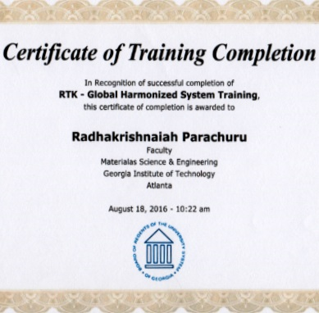
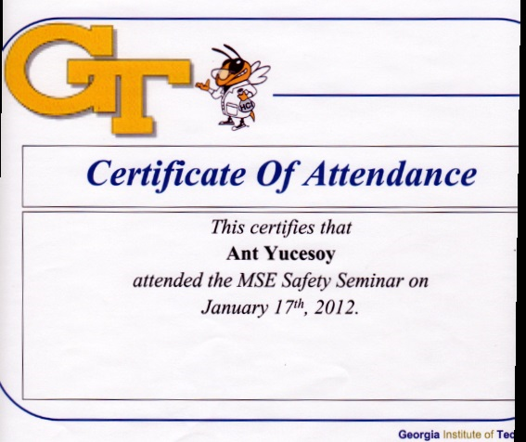
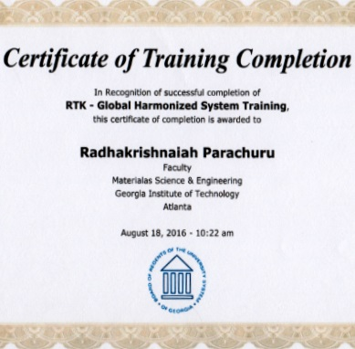
Training Certificates
RTK
Basic Laboratory Safety

Slide 7
Training Websites
Right-to-know
Basic Lab Safety (Lab Safety 101)
Online weblink for Right-to-know tutorial and quiz: http://www.usg.edu/facilities/rtk-ghs
The training is available through the Office of Human Resources and can be found at: http://www.trains.gatech.edu/courses/index#view-12388
1. Control click on the above link
2. Register yourself on the web page
3. Search for lab safety 101
4. Choose either Firefox or IE Explorer to take the tutorial and quiz

